Slide 1
La replicación del ADN…
Qué es???

Slide 2
La replicación del ADN…
Como toda polimerización
3 etapas
iniciación
elongación
Terminación

Slide 3
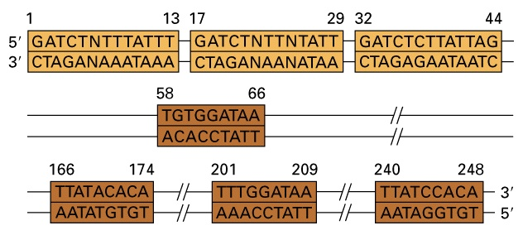
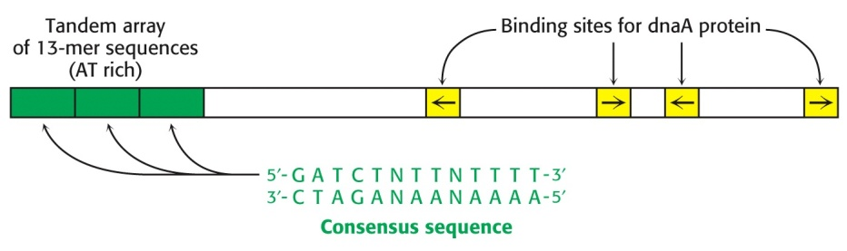
La replicación comienza en sitios específicos del cromosoma denominados
Orígen de replicación
Secuencia consenso mínima del orígen de replicación bacteriano
Los orígenes de replicación son: (1) segmentos únicos de ADN con múltiples repeticiones cortas, (2) reconocidas por proteínas de unión al origen multiméricas, y (3) usualmente contienen una secuencia rica en A-T

Slide 4
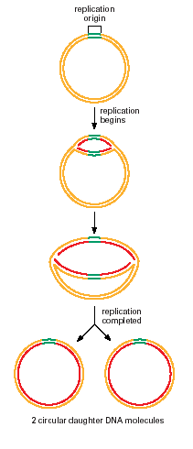
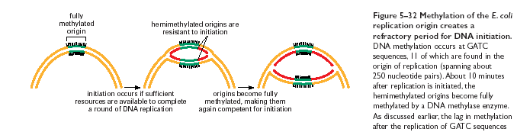

Slide 5
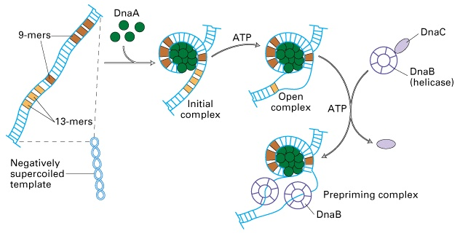
La proteína DnaA inicia la replicación en E. coli

Slide 6
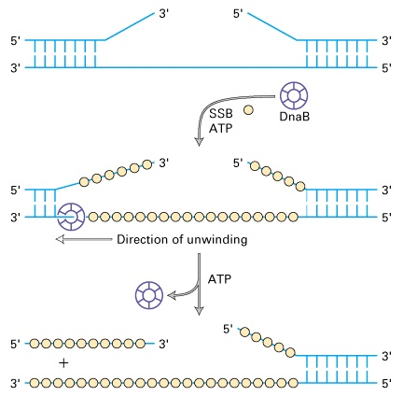
La proteína DnaB de E. coli es una helicasa que desnaturaliza la doble hebra de ADN

Slide 7
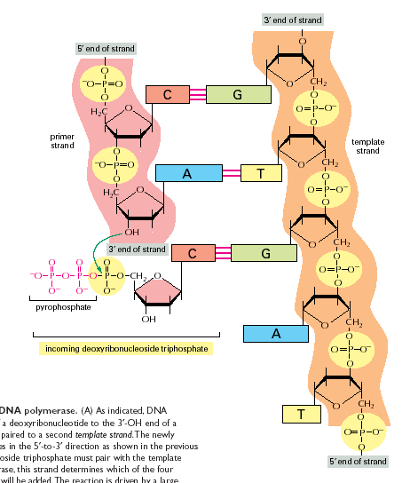
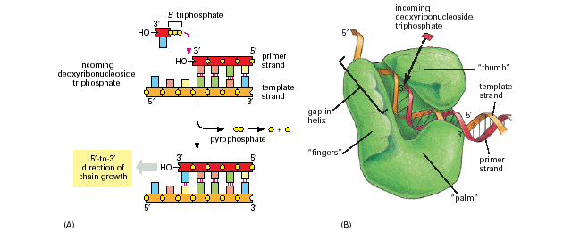
Reacción catalizada
por la DNA polimerasa

Slide 8
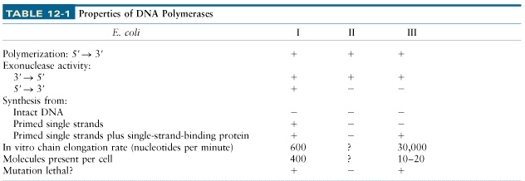
DNA polimerasas de E. coli

Slide 9
Para copiar el ADN la DNA polimerasa debe superar varios “problemas”
Las DNA polimerasas son incapaces de separar las cadenas de la doble hebra de ADN para exponer las cadenas a ser copiadas
Todas las DNA polimerasas conocidas sólo pueden elongar una cadena preexistente de ADN o ARN, son incapaces de iniciar cadenas
Las dos cadenas son antiparalelas, pero todas las DNA polimerasas catalizan la incorporación de nucleótidos al extremo 3′-hydroxilo de la cadena en crecimiento, por lo tanto sólo pueden crecer en la dirección 5′---->3′

Slide 10
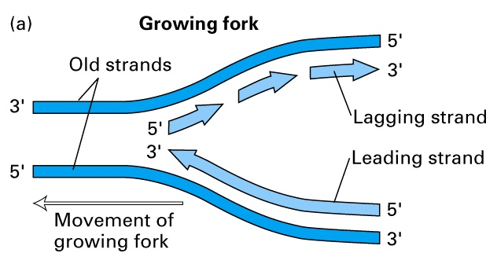
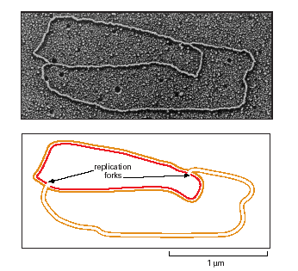
Dos horquillas de replicación moviéndose en dirección opuesta

Slide 11
En la horquilla, una cadena es sintetizada en forma discontínua a partir de múltiples cebadores

Slide 12
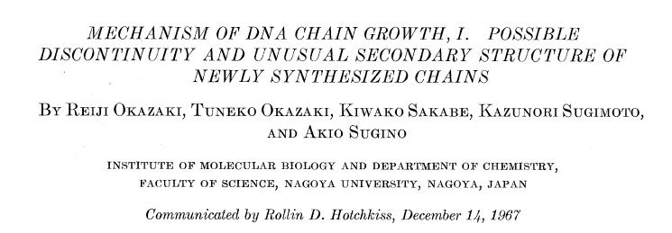

Slide 13
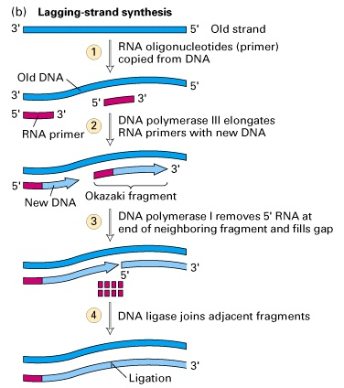
Sintesis de la cadena retrasada
(“lagging strand”)
Figure 12-9b

Slide 14
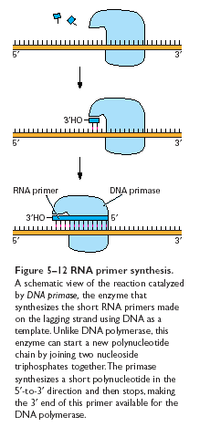
La primasa es una RNA polimerasa

Slide 15
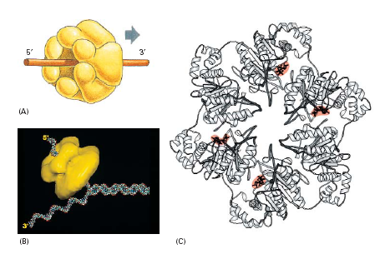
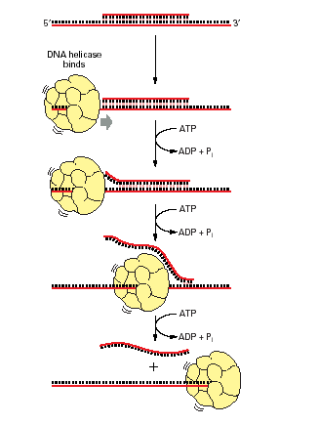
La helicasa

Slide 16
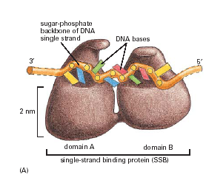
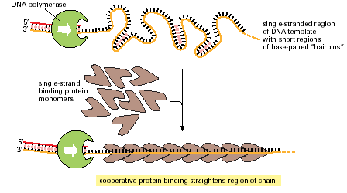
SSB proteins

Slide 17
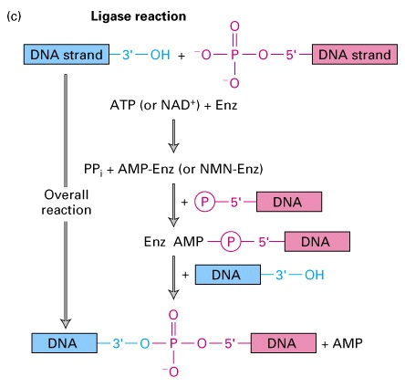
Los fragmentos de la cadena retrasada deben ser ligados para crear una cadena continua de DNA

Slide 18
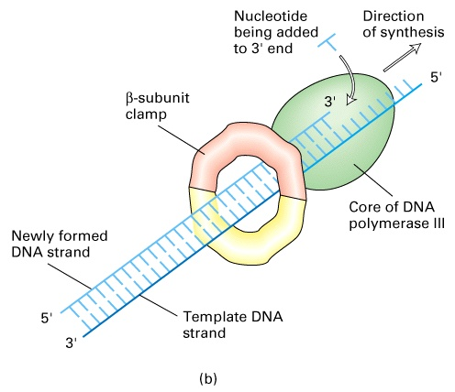
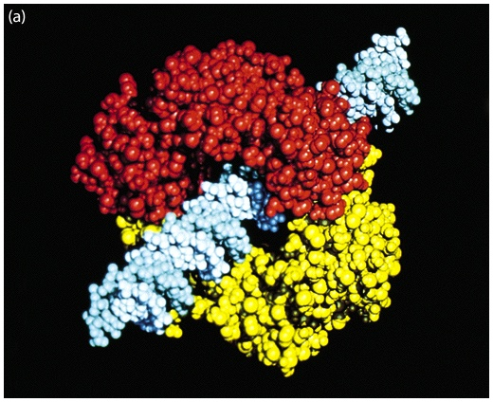
La procesividad de la DNA polimerasa es incrementada por un “clamp” del dímero de la subunidad β

Slide 19
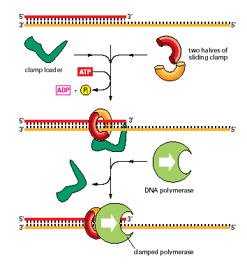
Se requiere de una proteína para “cargar” el clamp

Slide 20
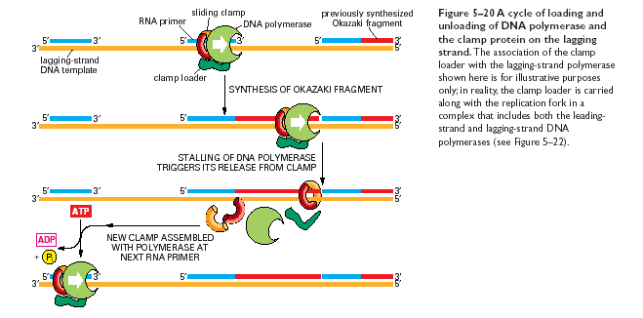

Slide 21
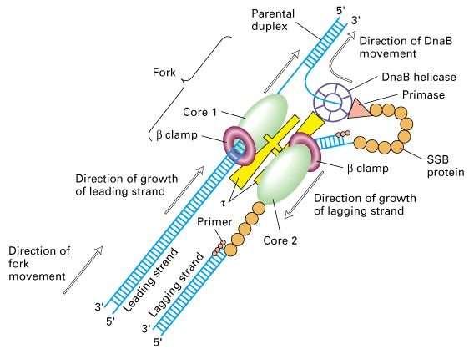
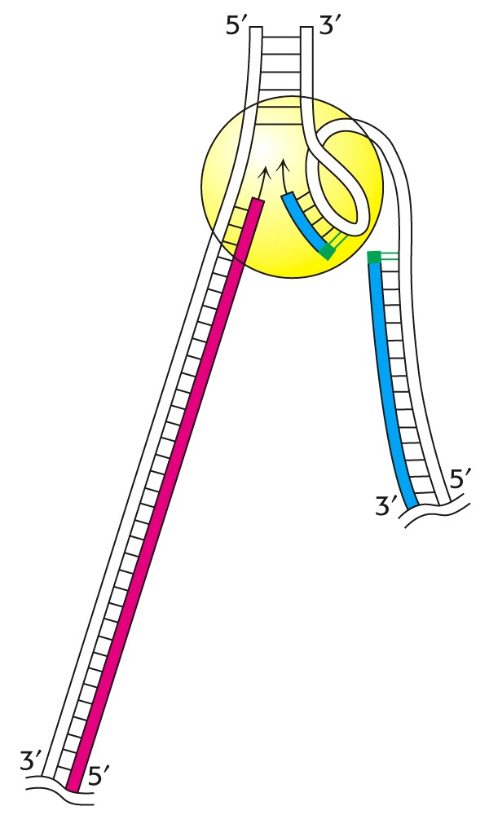
Ambas cadenas son sintetizadas en forma concurrente

Slide 22
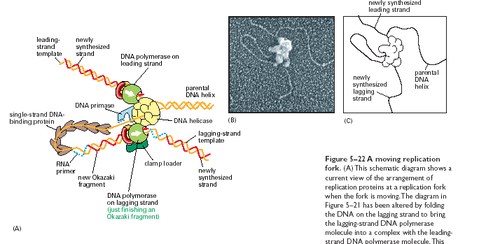

Slide 23


Slide 24
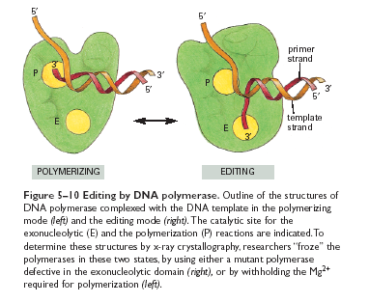
Corrección de errores

Slide 25
El cromosoma bacteriano es replicado bidireccionalmente como una unidad a partir del oriC
Las dos horquillas de replicación se mueven a lo largo del genoma (a aprox. la misma velocidad) hasta un punto de encuentro

Slide 26
Las secuencias involucradas en la terminación se denominas “sitios ter”
Son secuencias cortas ( 23 bp)
Funcionan en una única orientación
El sitio ter es reconocido por la proteína Tus (en E.coli) o RTF (en B.subtilis)

Slide 27
Punto de encuentro de las horquillas
TRAMPA de Horquilla de replicación
Si una horquilla se retrasa, la más rápida es “atrapada” en la región ter para esperar el arribo de la horquilla retrasada
terC,B
Terminan horquilla 2
terE,D,A
Terminan horquilla 1
Horquilla 2
Horquilla 1

Slide 28
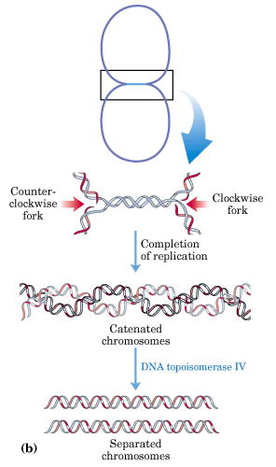
Los últimos cientos de bases de ADN entre estos complejos son replicados completando 2 cromosomas topológicamente unidos
La separación de los círculos (catenanos) se realiza por acción de la Topoisomerasa IV

Slide 29
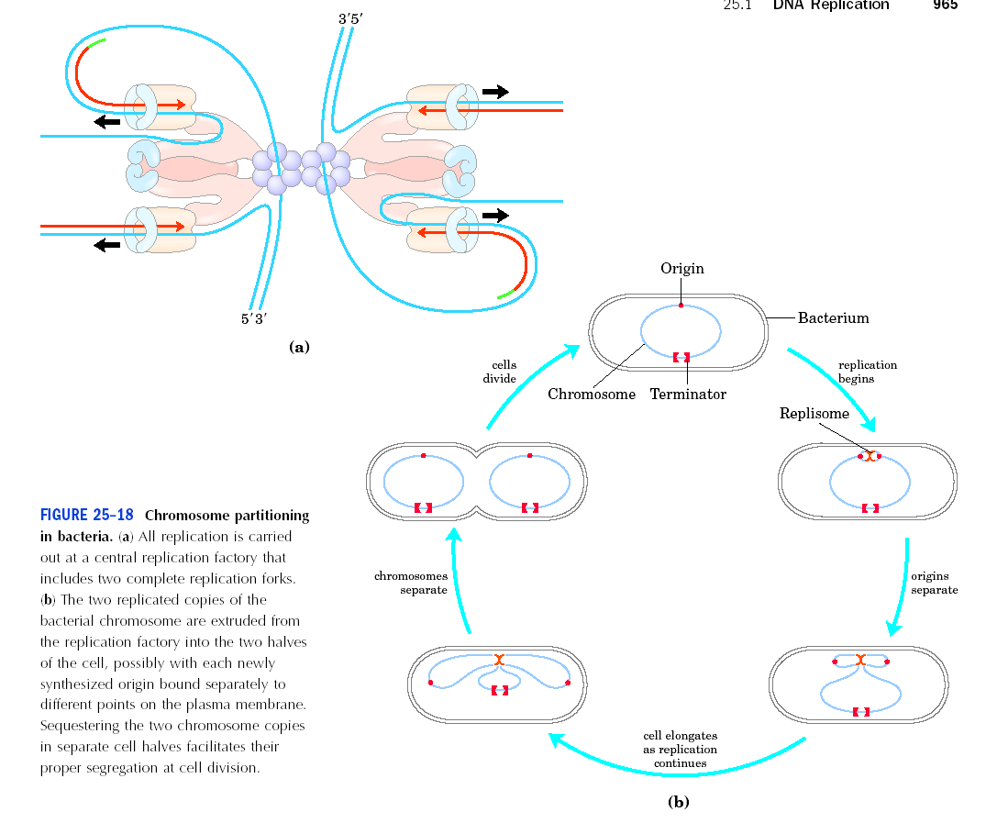
Los replisomas de ambas horquillas se encuentran ligados entre sí y asociados a la membrana en un punto

Slide 30
Después de la iniciación, cada uno de los orígenes replicados es particionado a una mitad de la célula
El proceso de replicación es la fuerza motriz que empuja los cromosomas replicados a los polos opuestos celulares

Slide 31
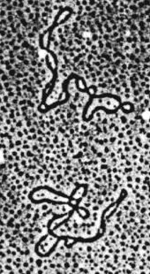

Plasmid replication and copy number control

Slide 32
Plasmids
Must be a replicon - self-replicating genetic unit
Plasmid DNA must replicate every time host cell divides or it will be lost
a. DNA replication
  partitioning (making sure each progeny cells receives a plasmid)
6. High copy plasmids are usually small; low copy plasmids can be large
7. Partitioning is strictly controlled for low copy, but loose for high copy
Plasmid replication requires host cell functions
Copy number is regulated by initiation of plasmid replication
10. Plasmids are incompatible when they cannot be stably maintained in the same cell because they interfere with each other’s replication.

Slide 33
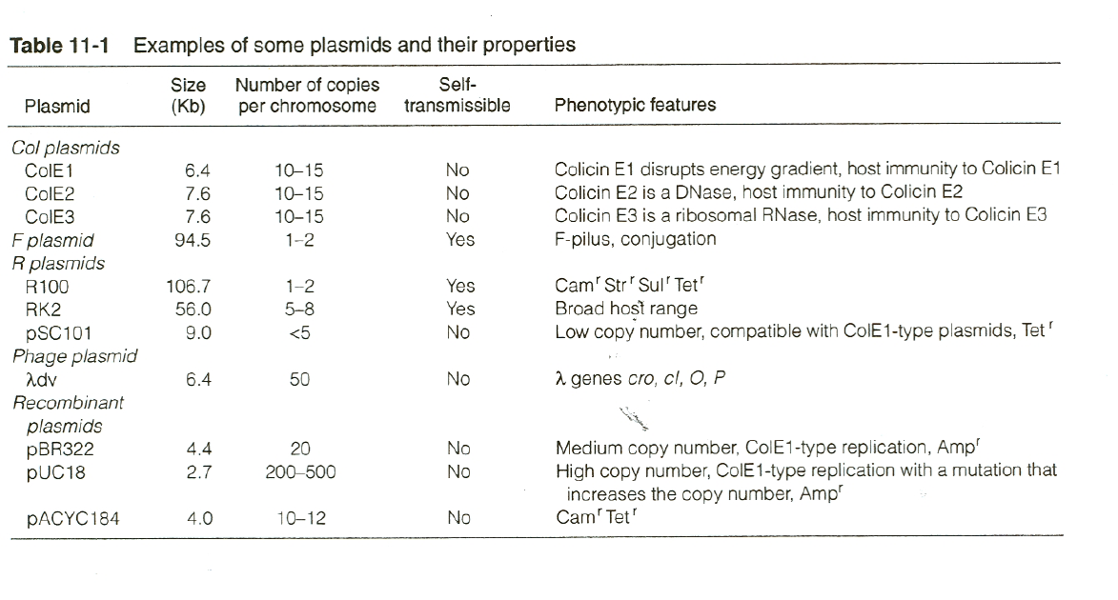

Slide 34
Plasmid replication
Plasmid replication requires host DNA replication machinery.
Most wild plasmids carry genes needed for transfer and copy number control.
All self replication plasmids have a oriV: origin of replication
Some plasmids carry and oriT: origin of transfer. These plasmids will also carry functions needed to be mobilized or mob genes.
Plasmid segregation is maintained by a par locus-a partition locus that ensures each daughter cells gets on plasmid. Not all plasmids have such sequences.
There are 5 main “incompatibility” groups of plasmid replication. Not all plasmids can live with each other.
Agents that disrupt DNA replication destabilize or cure plasmids from cells.

Slide 35
Plasmid replication mechanisms
Col E1 type replication (Theta Plasmid Replication)
Rolling circle
Iteron-containing replicons

Slide 36
Col E1 type replication (Theta Plasmid Replication)
In some replicons duplex melting depends on transcription, while other replicons rely on plasmid-encoded trans-acting proteins (Reps)
Rep-mediated duplex melting leads to loading of DnaB on the replication fork, often with DnaA assistance
In plasmids that instead rely on transcription for duplex melting, the transcript itself can be processed and become the primer for extension

Slide 37
REGULATION OF REPLICATION INITIATION

Slide 38
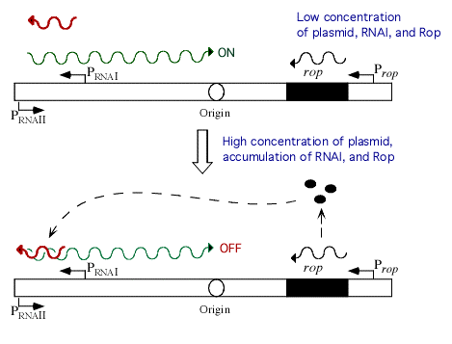
Anti-sense RNA replication control
RNA I-small inhibitory RNA that binds to RNAII. RNAII will act as a primer for DNA replication
Rop: plasmid encoded proteins which stabilizes the RNAI-RNAII complex
Antisense RNA: RNA-RNA hybrid blocks replication
GGCUAAUUCC Antisense RNA is also used in euks called
CCGAUUAAGG siRNA
Blocking RNA priming for DNA PolI prevents replication

Slide 39
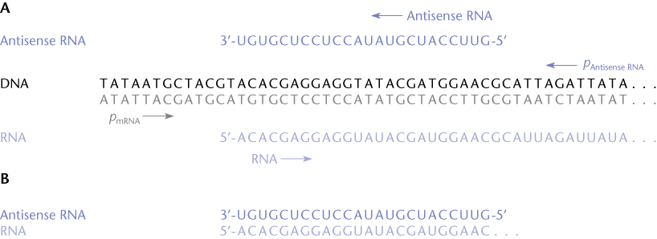
Antisense RNA gene control.
-the RNA-RNA hybrid is very stable
-blocks most translation and tanscription
-requires RNAases to degrade

Slide 40
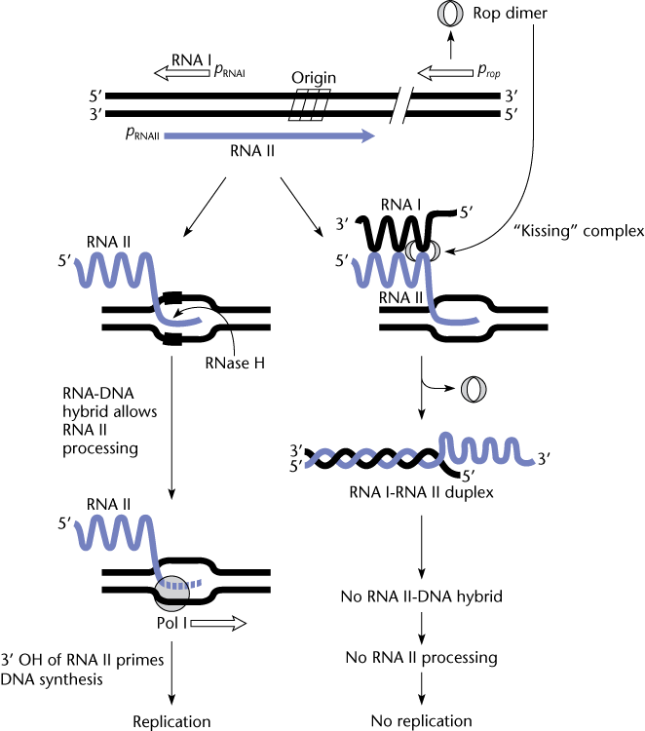
ColE1 Replication Control-an example of primer control of replication
RNAII will serve as a primer for the replication fork.
The 3’ end is processed by host RnaseH to allow efficient RNA-DNA hybrid to form
The hybrid acts as a primer for host Pol1
As the concentration of plasmid increases, Rop does also
Rop stabilizes the RNA1-II complex
No RNA for replication priming.
ColE1 replication does not need plasmid encoded rep proteins

Slide 41
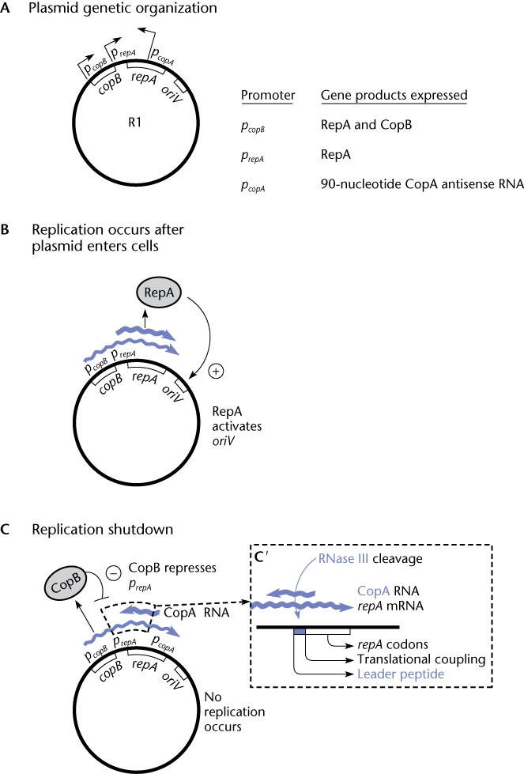
The events upon entry into a cell
RepA mRNA is made from Prep until copy number becomes high
CopB expression increase an Cop represses RepA expression at PrepA
CopA now is made-a 90base antisense RNA
CopA binds to 5-end of the RepA mRNA, forming dsRNA
This is recognized by host RNAaseIII and degraded.
Thus concentration of RepA protein is maintained by rate of RNA-RNA hybrid formation.

Slide 42
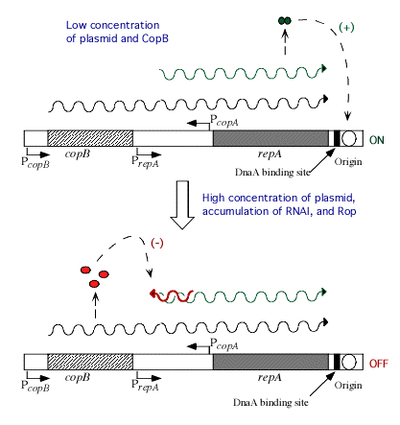
Rep-protein control -R1 family of plamsids.
Rep-protein expression controlled by antisense CopA
PcopB-encodes Rep and CopB
PcopA-encodes antisense RNA
-plasmid replicates to high level
-CopB levels rise, shutting off RepA production
-antisense RNA from PcopA made
-complexes with repA mRNA
Host RNaseIII will cleave the complex
Plasmid copy control balanced by host RNaseIII activity and transcription from the plasmid.

Slide 43
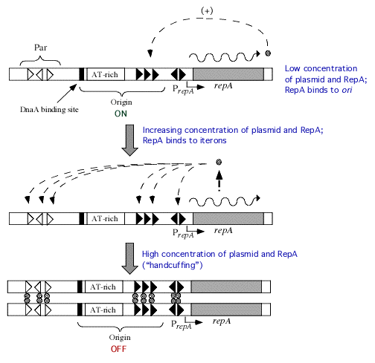
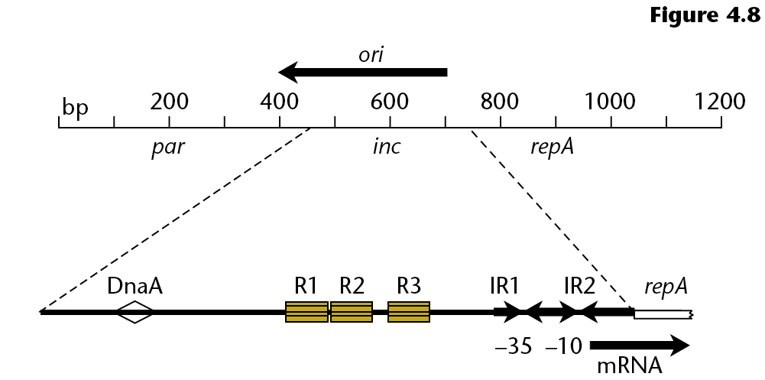
Iteron Plasmids: Handcuffing RK2 and other broad host range plasmids
RepA is able to bind the repeat sequences upstream of the promoter region for repA.
-binding causes two plasmid molecules to couple “handcuff”
-prevents replication.
“copy up” mutants: mutations in RepA that are less able to bind to each other.

Slide 44
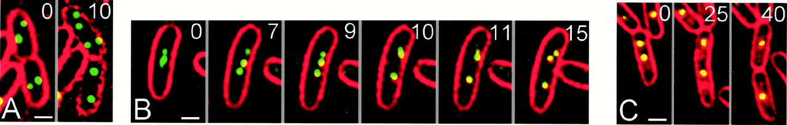
Incompatibility Groups
Not all plasmids can live together.
Plasmids that are able to coexist in the same cell do not interfere with each other’s replication
A single cell can have as many Inc group plasmids as it can tolerate and replicate!
Partion Locus: a region on broad host range plasmids that binds to a structure on the inner membrane of the cell to ensure proper segregation. Plasmids labeled with fluorescent protein
-move to each daughter cell during division.
Pogliano, Joe et al. (2001) Proc. Natl. Acad. Sci. USA 98, 4486-4491

Slide 45
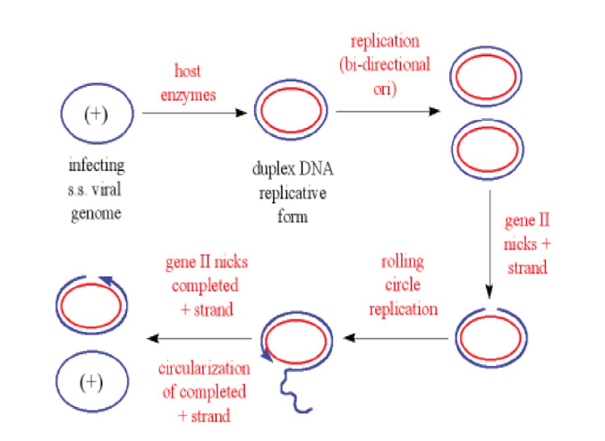
Rolling circle
Rolling circle replication mechanism is specific to bacteriophage family M13 and the fertility F factor which encodes for sex pili formation during recombination by means of conjugation
Rolling circle occurs to a covalently closed circular piece of double-stranded DNA. A nick is produced in one of the strands by enzyme nickases creating a 5’ phosphate and a 3’ hydroxyl. Free 3’

Slide 46
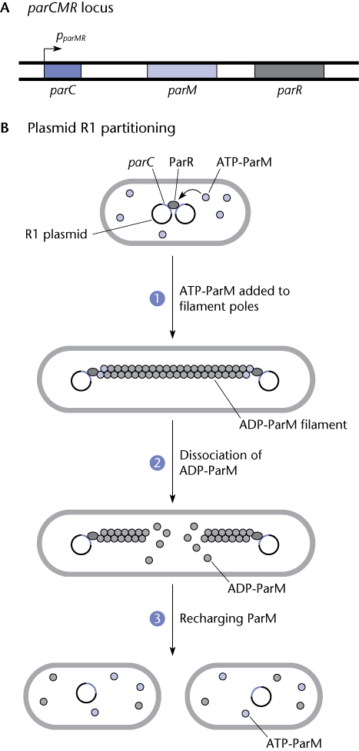
Par locus
-think of this as a primitive centromere
-the growing filaments push the plasmids to the opposite poles of the cells

